Slide 1

Capstone Project

Slide 2

Problem statement:
In this project we can see the growth of the business from start up to big giants.
Day by day start up companies are coming in market .
Every time funds are raised for the companies .Its necessary to monitor those funds for that purpose these system is design.

Slide 3
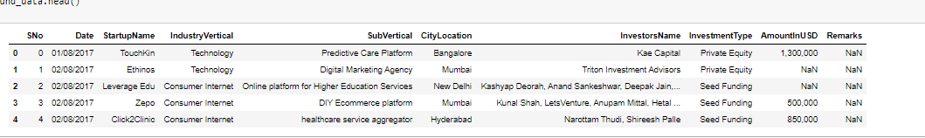
Dataset for the system

Slide 4
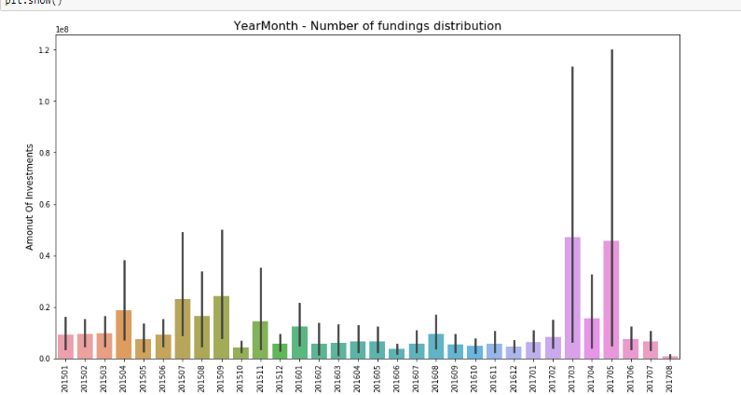
Data Analysis
In these problem statement it is important part to handle the funds ,and also to take care of the investment made by the company.

Slide 5
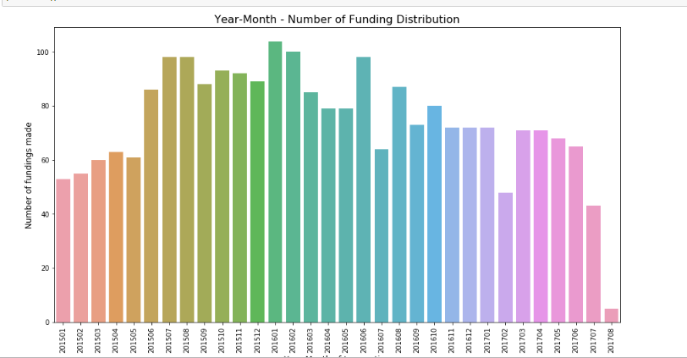
Conclusion
This project is based on analysis for the funds distributed over a period of time .
The data is in the form of csv.
We can easily classify by the name of various parameters.

